Slide 1


Slide 2
Development of Modern Web Applications
Bachelor Thesis
Student: Thanh Tuan Nguyen Supervisor: Ing. Michal Radecký, Ph.D., MBA

Slide 3
Purpose
The purpose of the thesis is to create a modern website with any of today's popular and diverse web programming languages. With the implementation in the thesis, users can understand how to use this language.

Slide 4

Framework/Library
Front-end: React
Back-end: Node and Express
Database: MongoDB
=> MERN Stack

Slide 5

1. Based on case study and design it
Currently, with the development of the internet, people's needs to use the internet are increasing and websites are gradually becoming more diverse to attract users to access.
So, to design a website, developers need to consult many websites to be able to create a website for themselves.

Slide 6
2. Implement Page and Feature
Page:
Home Page
Product Page
Product Details Page
About Page
Contact Page
Cart Page
E-commerce, Size Guide, FAQ, Ship Policy, Privacy Policy, Return Policy Page
Login and Register Page
Feature:
Sign in, sign up, sign out.
Search product.
Dark/light mode.
Localization
Filter
Change product details in the cart (Add or remove product in the cart).
Enter payment details, including customer's information, and other required information.
Quick Buy
Responsive

Slide 7
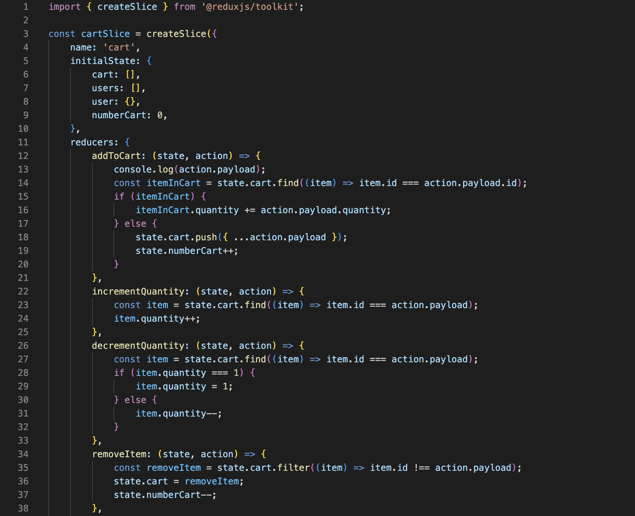
3. Some Implementation Problem
There are quite a few problem and difficulties in the implementation process, the important thing is shopping cart and login and registration because they have to use Redux to store data to LocalStorage. I'm not good at Redux, so I also tried to refer to many sources to fix and fix a lot to make them saveable. And with some problem about Dark Mode.
And then I want to improve my product, so I use Backend, even though I'm not perfect because Backend I'm not good at and fully understand them even React I'm not confident that I'm perfect. But in order to work properly when executing, I also find it to be temporary.

Slide 8
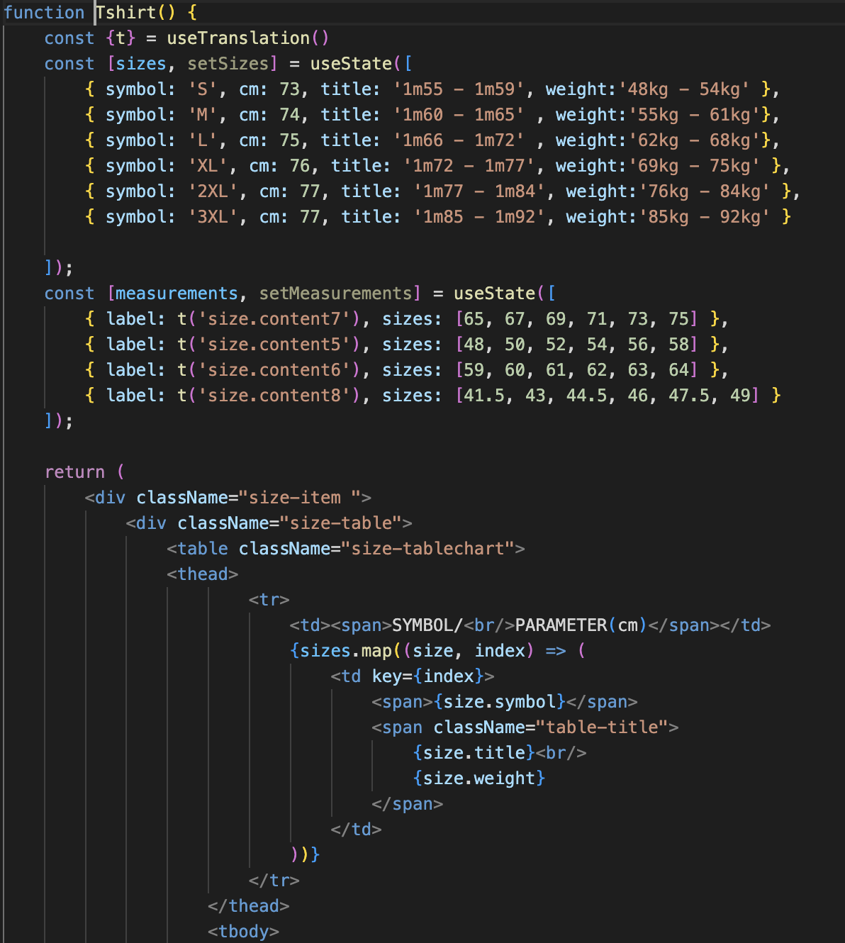
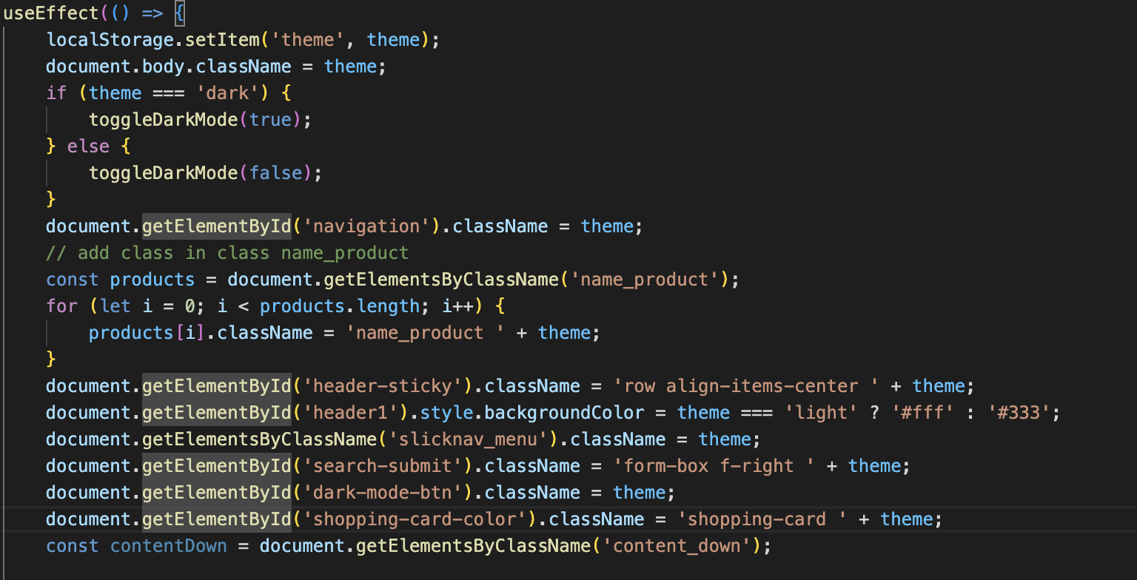
3. Some Implementation

Slide 9
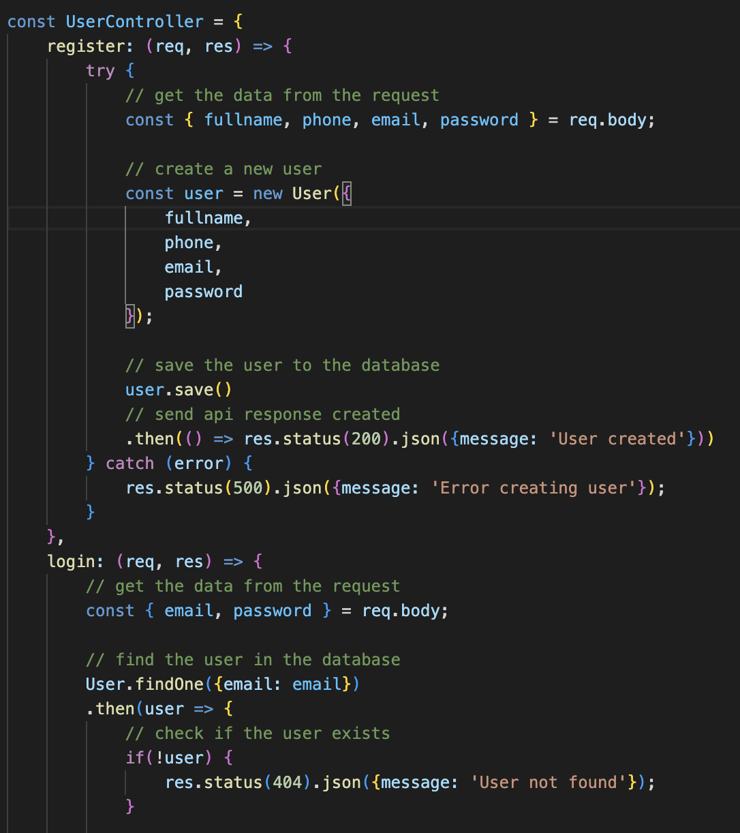
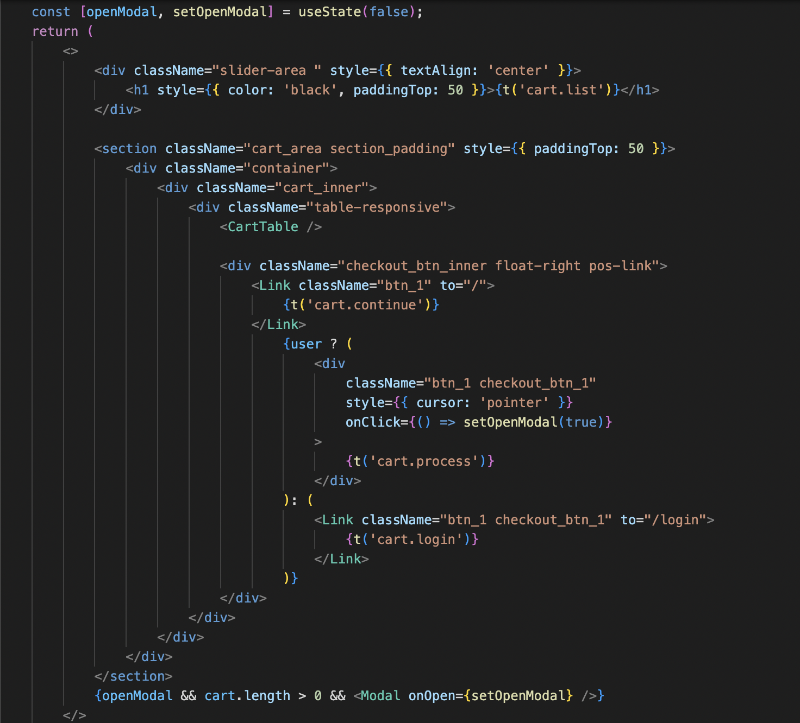
3. Some Implementation

Slide 10
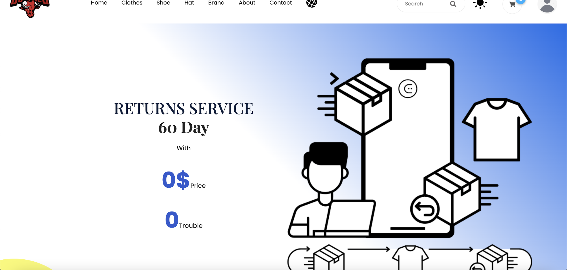
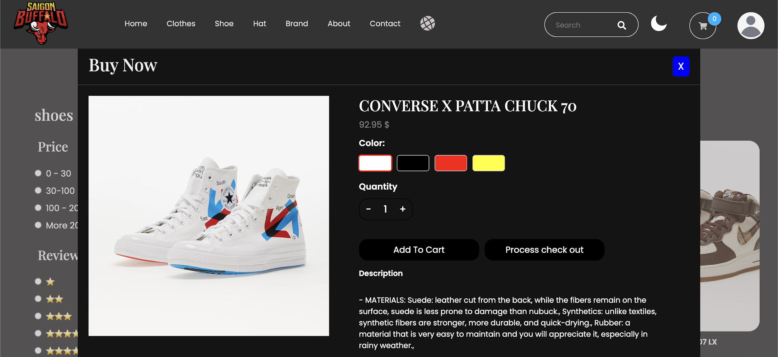
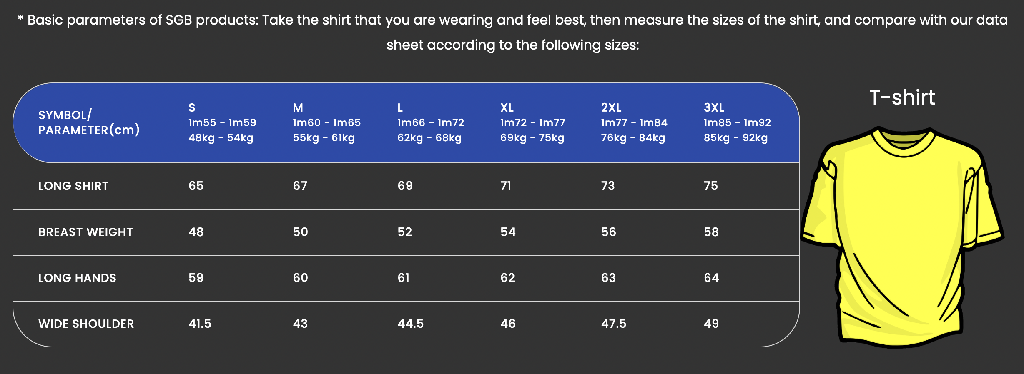
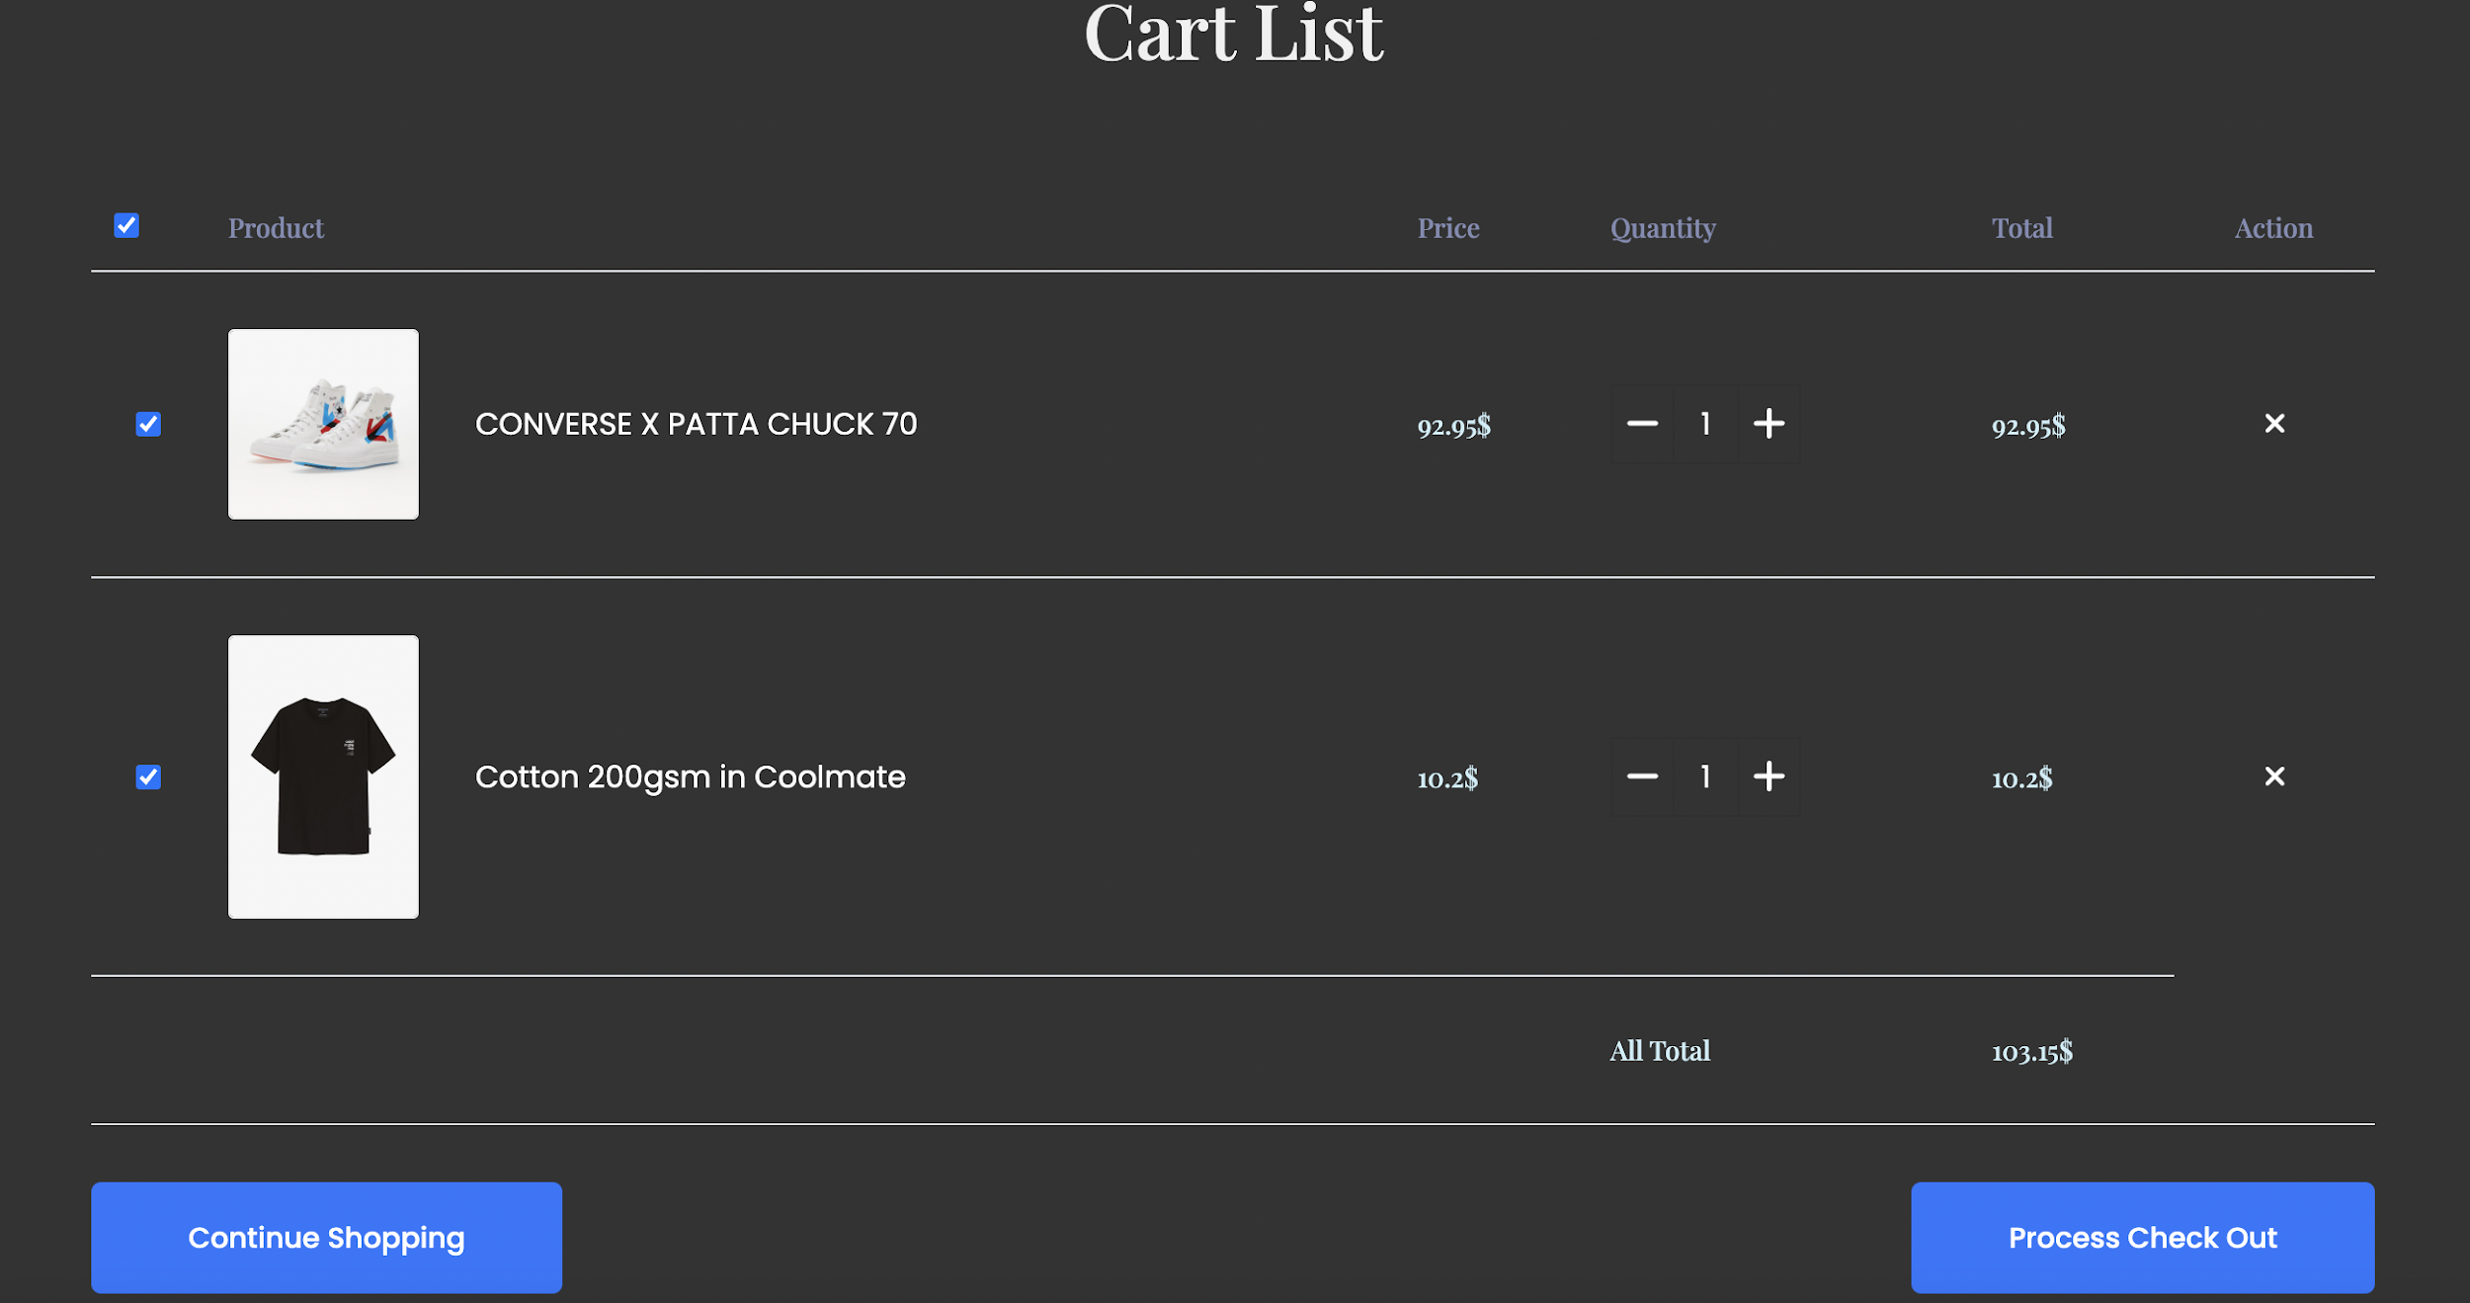
4. Some Image for implementation

Slide 11
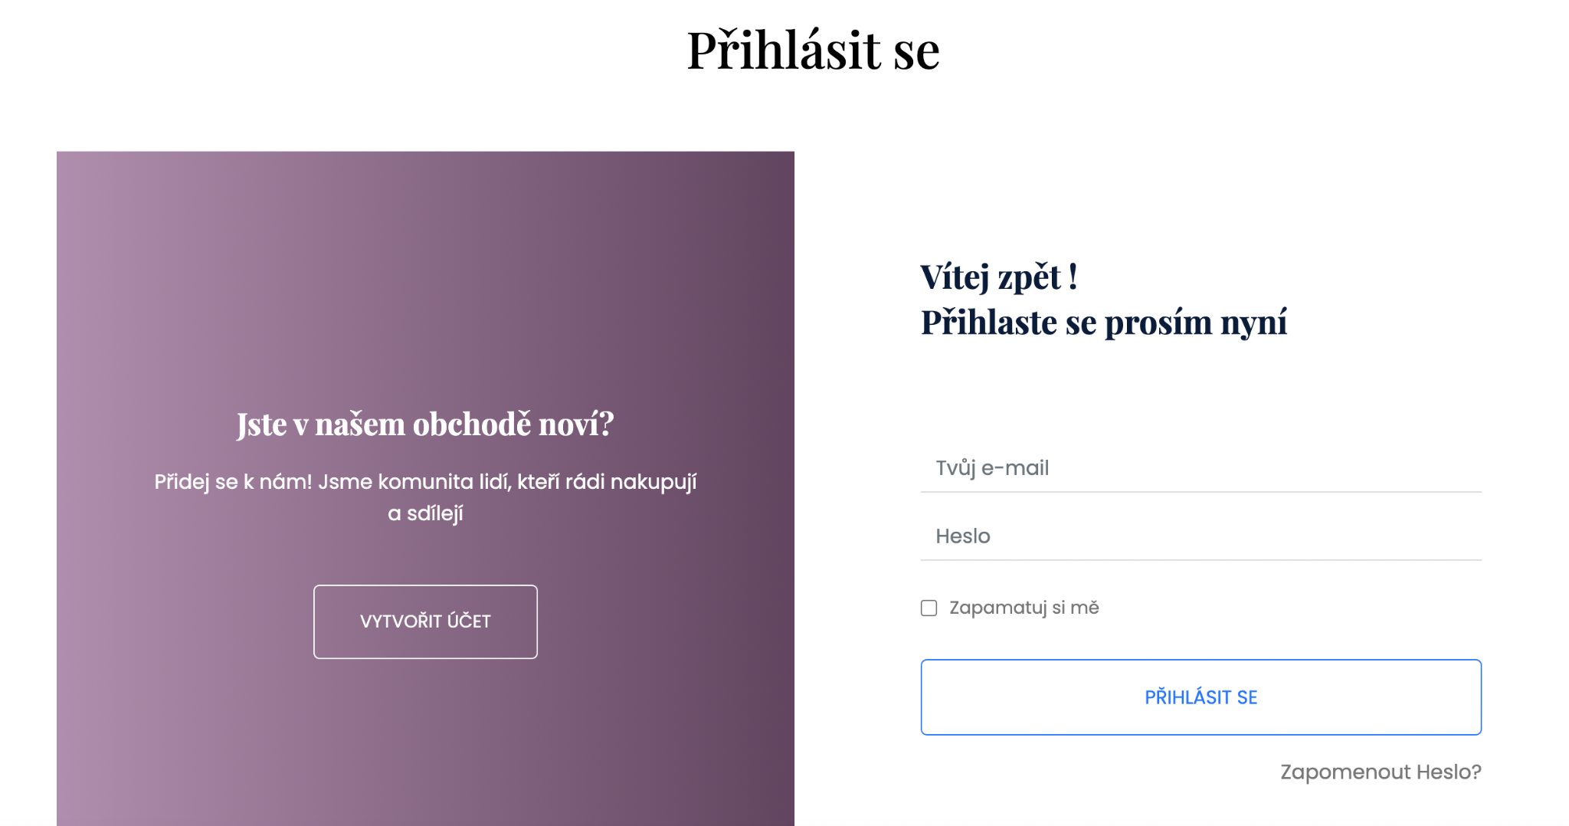
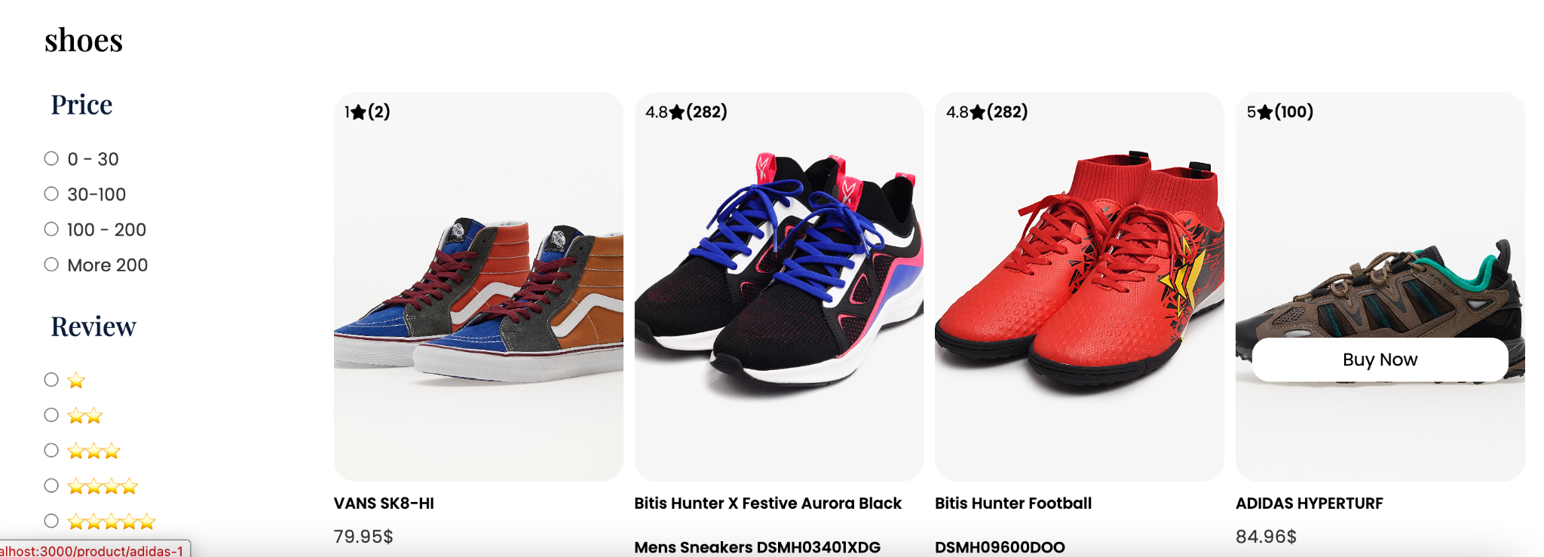
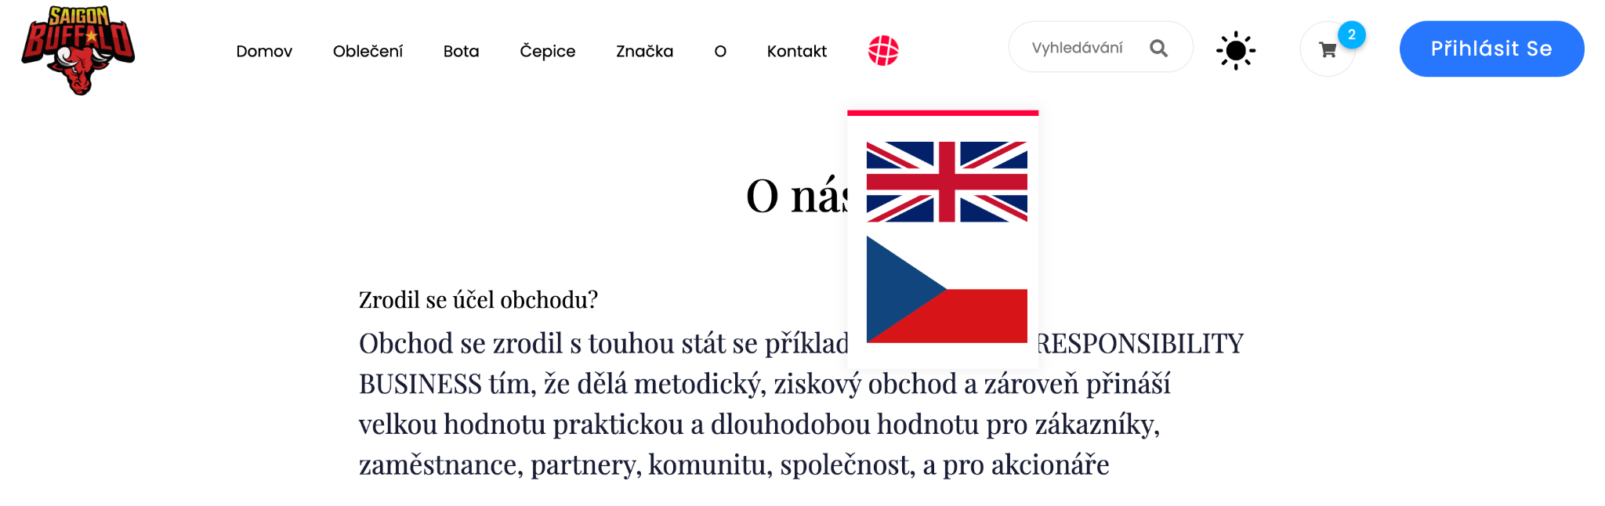
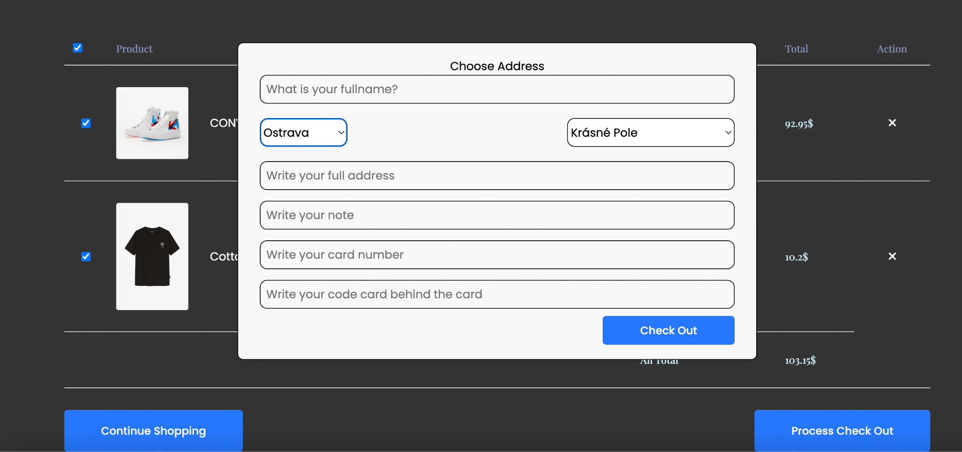
4. Some Image for implementation

Slide 12
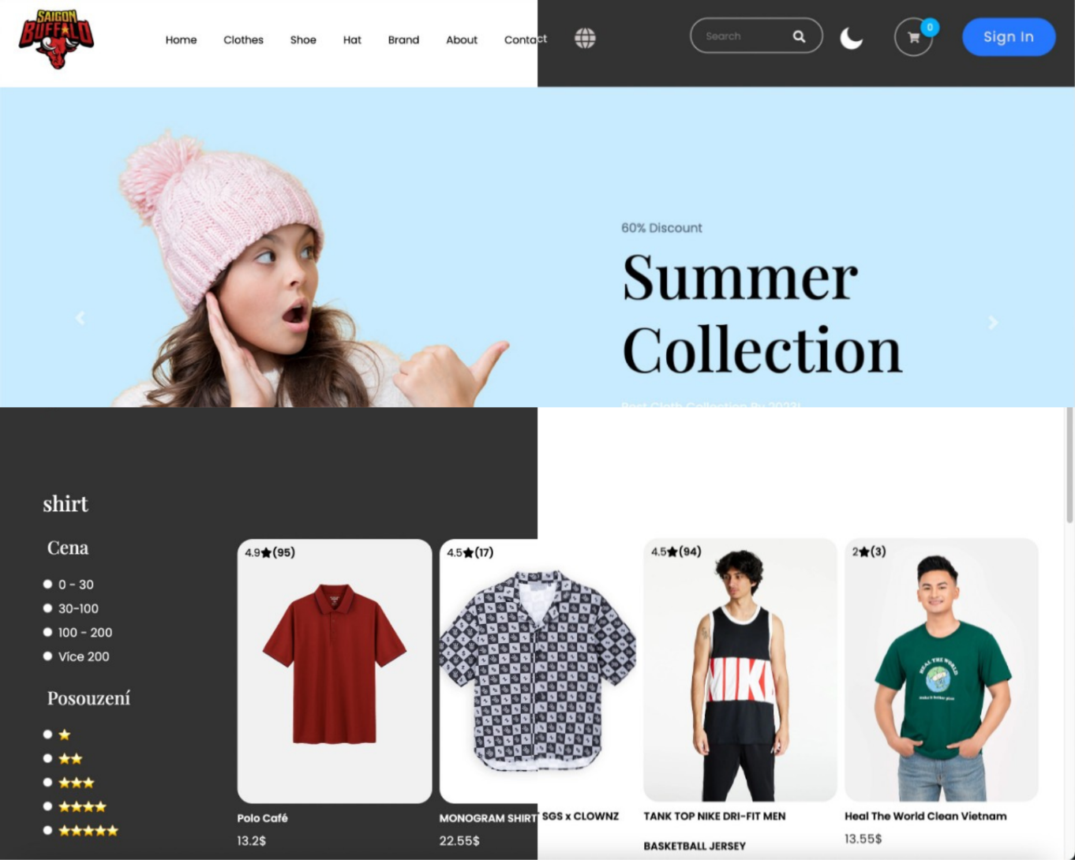
5. Evaluation
After completing the e-commerce project, there are still many shortcomings. The speed of startup and display after activating npm start is still stable and guaranteed, users can access and use it, the product page loads data from the Back-end is still stable without lag. These functions and the website are fully functional.
In the future, besides overcoming shortcomings, I will continuously update technology and perfect my products. So that they will be more modern and better application.

Slide 13
Thank you
for your attention

Slide 14
Question of Supervisor
Question:
1/ Why did you choose the framework you did for the implementation of the eshop?
2/ What do you consider to be the biggest problem when developing an e-shop using the chosen technologies?
3/ How would you briefly summarize the main advantages of HTML 5 in terms of development and operation of modern e-shops?
Answer:
1/ Because ReactJS is one of the most popular and widely used frameworks/libraries. So there will be a lot of supporting documents during the project implementation that will minimize the difficulties that users encounter.
2/ My difficulty when doing e-shop is connecting and using technologies together, because sometimes I don't know how to connect data and I am also quite confused in learning how to use each and apply them to products, especially the shopping cart section. I'm having a lot of trouble using Redux to store data for my shopping cart.
3/HTML5 offers improved multimedia support, enhanced semantic structure, mobile-friendly and responsive design, offline capabilities, simplified form handling, better performance, and efficiency. These advantages facilitate the development and operation of modern e-shops.

Slide 15
Question of Opponent
Question:
1/ Why did you choose React for your implementation?
2/ Do you believe that it is appropriate to implement the frontend of the e-shop as a single-page application?
Answer:
1/ Because ReactJS is one of the most popular and widely used frameworks/libraries. So there will be a lot of supporting documents during the project implementation that will minimize the difficulties that users encounter.
2/ Yes, implementing the frontend of an e-shop as a single-page application (SPA) can be appropriate in many cases. SPAs provide a smooth and interactive user experience by loading the necessary resources upfront and dynamically updating the content without full page reloads.

